Slide 1
e
0
Group: Time
Saad Qureshi
Zain Ahmed Usmani
Ayyan Bin Fawad
Aumaima Rahid
Haider Abbas
e
-1
ee
Eertree -
Palindromic Trees

Slide 2

racecar
AGTCXCTGA
1991
What is a palindrome?
eertree
level
rotator
Notes:
Palindrome: Any string that is equal to its reverse
Some problems with Palindromes:
Some problems:
○ Counting palindromes in a string.
○ Factorization of a string into a palindromes.
§ K-Even palindromes.

Slide 3
Each node stores α palindrome.
fast access to all palindromic substrings of α string
Mikhail Rubinchik (2015)
What is an eertree?
Inherits suffix trie and suffix tree.
Directed graph
O(n)
not a tree exactly

Slide 4
fast access to all palindromic substrings of a string
O(n)
It’s a tree
What is an eertree?
Directed graph
Inherits both a suffix trie and suffix tree.
Each nodes stores a palindrome.

Slide 5
Provides fast access to all palindromic substrings of a string or a set of strings
Linear-size
data structure
What is an eertree?
Directed graph
Inherits both a suffix trie and suffix tree.
Each nodes stores a palindrome.

Slide 6
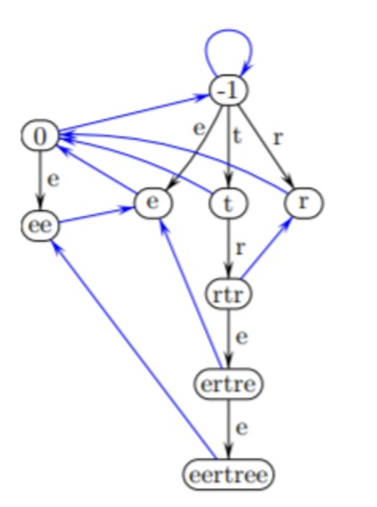
How does it work?
Black Edge represent edges
Blue Edge represents Suffix Link
A Black Edge goes from node 'u' to 'xux'
A Blue Edge is an unlabeled suffix link goes from 'u' to 'v' if 'v' is the longest proper suffix palindrome of 'u'
For adding an element 'c', we append 'c' to the string and the eertree returns the number of new palindromes in the string
The Eertree of the palindromic string eertree

Slide 7
How does it work?
Black Edge represent edges
Blue Edge represents Suffix Link
e
sus
u
e
x
-1
x
xux
ee
xux
-1
=
0
“”
Imaginary string
The Eertree of the string eertree

Slide 8
Aren’t there simpler ways to find palindromes?
Approach | Space Complexity | Time Complexity
Compare original string with new reserved string | O(n) | O(n²)
Fast/Slow pointer | O(1)* | O(n)
Comparing left and right side with pointer | ? | O(n)
Eertree | O(n) | O(nlogσ)
Notes:
Links to explanations:
Eertree: https://www.sciencedirect.com/science/article/pii/S0020019021000892#fg0010
Left/right and reversed string: https://javascript.plainenglish.io/the-best-and-worst-way-of-solving-the-palindrome-question-4b7d2f9ada06
Fast/slow pointer: https://medium.com/@suprajaraman/problem-statement-palindromes-70ffe1ba1905

Slide 9
Simpler ways to find all palindromic substrings?
Approach | Space Complexity | Time Complexity
Brute force | O(1) | O(n³)
Manacher’s Algorithm | O(1) | O(n²)
Eertree | O(n) | O(n)
Notes:
Links to explanations:
Eertree: https://www.sciencedirect.com/science/article/pii/S0020019021000892#fg0010
Left/right and reversed string: https://javascript.plainenglish.io/the-best-and-worst-way-of-solving-the-palindrome-question-4b7d2f9ada06
Fast/slow pointer: https://medium.com/@suprajaraman/problem-statement-palindromes-70ffe1ba1905

Slide 10
Simpler ways to find all palindromic substrings?
Brute force | O(1) | O(n³)
def returnPalindromes(s):
for i in range(len(s)): # O(n)
for j in range(len(s)): # O(n)
# check if s[i:j] is palindrome # O(n)
# add to palindromeList
return palindromesList # O(n^3)
O(n²) for substrings
O(n) for identifying palindromes
Notes:
Links to explanations:
Eertree: https://www.sciencedirect.com/science/article/pii/S0020019021000892#fg0010
Left/right and reversed string: https://javascript.plainenglish.io/the-best-and-worst-way-of-solving-the-palindrome-question-4b7d2f9ada06
Fast/slow pointer: https://medium.com/@suprajaraman/problem-statement-palindromes-70ffe1ba1905

Slide 11
Simpler ways to find all palindromic substrings?
Manacher’s Algorithm | O(1) | O(n²)
AGTCXCTGA
…
…
Algorithm for longest palindromic string
Goes from centre to outward, checking if each character matches // O(n) per run
There are n possible centres // O(n*n)
Notes:
Links to explanations:
Eertree: https://www.sciencedirect.com/science/article/pii/S0020019021000892#fg0010
Left/right and reversed string: https://javascript.plainenglish.io/the-best-and-worst-way-of-solving-the-palindrome-question-4b7d2f9ada06
Fast/slow pointer: https://medium.com/@suprajaraman/problem-statement-palindromes-70ffe1ba1905

Slide 12
Simpler ways to find all palindromic substrings?
Eertree | O(n) | O(n)
Builds like DFS,
O(V+E) complexity
Notes:
Links to explanations:
Eertree: https://www.sciencedirect.com/science/article/pii/S0020019021000892#fg0010
Left/right and reversed string: https://javascript.plainenglish.io/the-best-and-worst-way-of-solving-the-palindrome-question-4b7d2f9ada06
Fast/slow pointer: https://medium.com/@suprajaraman/problem-statement-palindromes-70ffe1ba1905

Slide 13
Simpler ways to find all palindromic substrings?
Eertree | O(n) | O(n)
Build time
You’re only storing lengths in the ideal eertree (this eertree has space complexity O(n^2)
Builds like DFS,
O(V+E) complexity
V = n+2, E = n
O(2n+2)
Notes:
Links to explanations:
Eertree: https://www.sciencedirect.com/science/article/pii/S0020019021000892#fg0010
Left/right and reversed string: https://javascript.plainenglish.io/the-best-and-worst-way-of-solving-the-palindrome-question-4b7d2f9ada06
Fast/slow pointer: https://medium.com/@suprajaraman/problem-statement-palindromes-70ffe1ba1905

Slide 14
O(n)
Complexity of an eertree
O(nlogσ)

Slide 15
Complexity of an eertree
Notes:
This guy: https://www.sciencedirect.com/science/article/pii/S0020019021000892#fg0010

Slide 16
✅
O(n)
Complexity of an eertree
✅
O(nlogσ)

Slide 17
💾
Applications of Eertrees
🧬

Slide 18
💾
Applications of Eertrees
🧬
DNA Sequencing:
A,C,G,T
Restriction Enzymes
Gene similarity
Instability of genes (helps predict cancer risk, diagnose weaknesses etc.)
Shortest Unique Substring:
Gene sequencing, information Retrieval

Slide 19
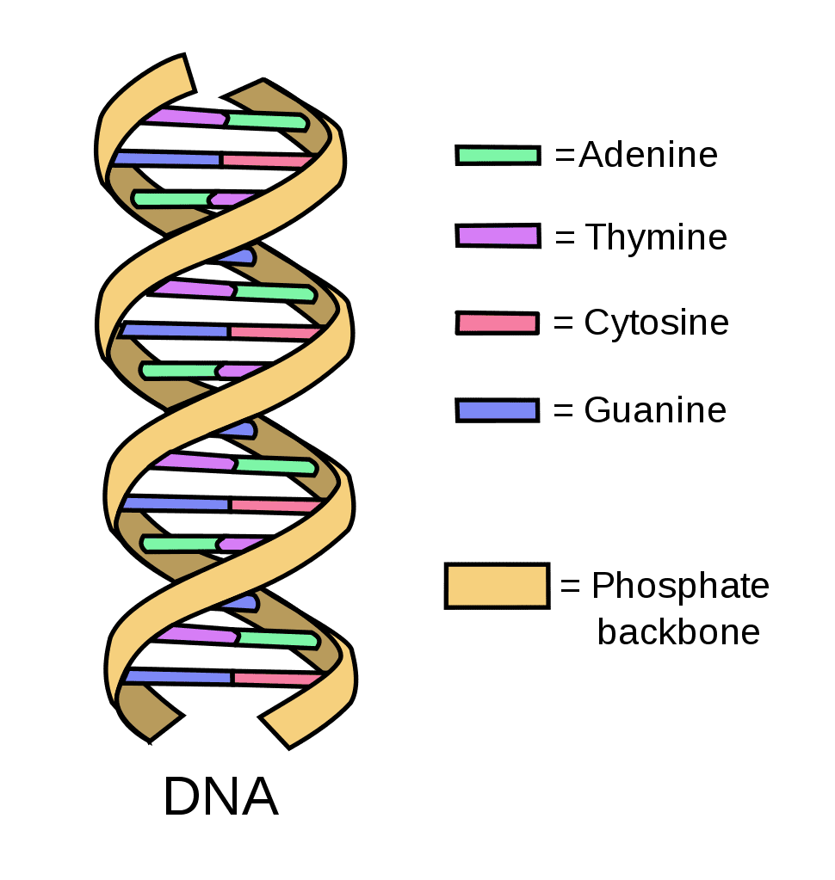
DNA Deoxyribonucleic acid
hereditary material in organisms

Slide 20
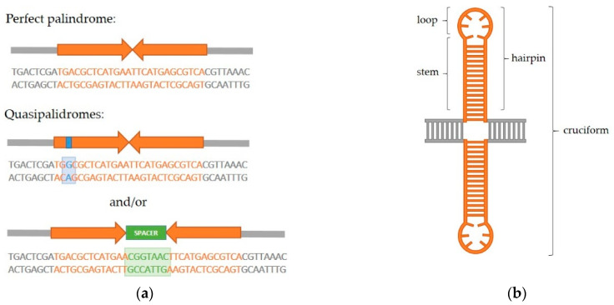
Palindromes in DNA
A Risk for Genome Stability and Implications in Cancer
A quasipalindrome can contain mismatches, perfect doesn’t
secondary structure formation due to intrastrand base pairing
potential to form secondary structures in DNA present, a risk for Genome Stability since these structures can result in double-strand DNA breaks (DSBs)
genetic
recombination
> translocations
> deletions
> gene amplifications

Slide 21
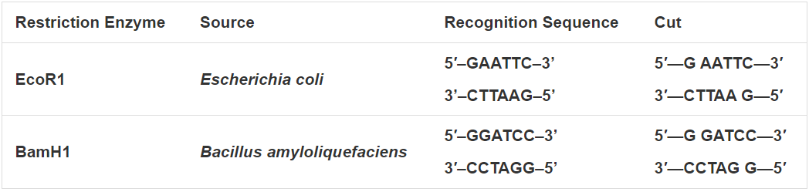
Restriction Enzymes
identify a specific palindrome site and cut the DNA strands.
Analyzing DNA molecules
Determining neucleotide sequence of long DNA molecules
Creating recombinant DNA molecules
Cloning and amplifying

Slide 22
Comparing DNA strings
Comparing instability of different genes
1
Identifying recurring palindromic sequences
2

Slide 23
💾
Applications of Eertrees
🧬
Demo

Slide 24
References
https://scienceprimer.com/palindromic-sequences#:~:text=Restriction%20enzymes%20cut%20double%2Dstranded,sequences%20they%20recognize%20are%20palindromic.
https://journals.plos.org/ploscompbiol/article?id=10.1371/journal.pcbi.0030039
https://www.bioinformatics.org/sms2/random_dna.html?
John K. Eykelenboom, John K. Blackwood, Ewa Okely, David R.F. Leach, SbcCD Causes a Double-Strand Break at a DNA Palindrome in the Escherichia coli Chromosome, Molecular Cell, Volume 29, Issue 5, 2008, Pages 644-651, ISSN 1097-2765,
https://doi.org/10.1016/j.molcel.2007.12.020.
(https://www.sciencedirect.com/science/article/pii/S1097276508000397)
https://www.sciencedirect.com/topics/biochemistry-genetics-and-molecular-biology/genome-instability
https://www.ncbi.nlm.nih.gov/pmc/articles/PMC7999016/
https://www.ncbi.nlm.nih.gov/books/NBK21136/
https://www.sciencedirect.com/topics/neuroscience/palindromic-sequence
https://www.sciencedirect.com/topics/biochemistry-genetics-and-molecular-biology/genetic-recombination

Slide 25
Thank you!

